Slide 1
Evolutionary Computing
Chapter 1: Problems to be solved

Slide 2
Chapter 1: Problems to be solved
Problems can be classified in different ways:
Black box model
Search problems
Optimisation vs constraint satisfaction
NP problems

Slide 3
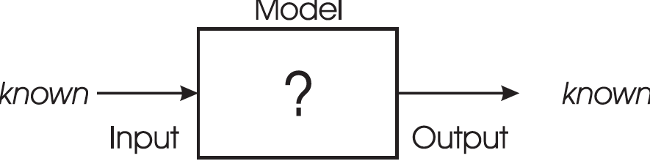
“Black box” model
“Black box” model consists of 3 components
When one component is unknown: new problem type

Slide 4
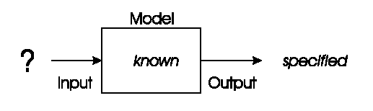
“Black box” model: Optimisation
Model and desired output is known, task is to find inputs
Examples:
Time tables for university, call center, or hospital
Design specifications
Traveling salesman problem (TSP)
Eight-queens problem, etc.

Slide 5
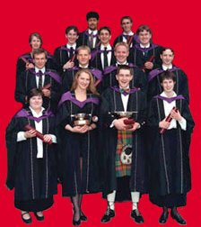
Optimisation example 1: university timetabling
Enormously big search space
Timetables must be good
“Good” is defined by a number of competing criteria
Timetables must be feasible
Vast majority of search space is infeasible

Slide 6
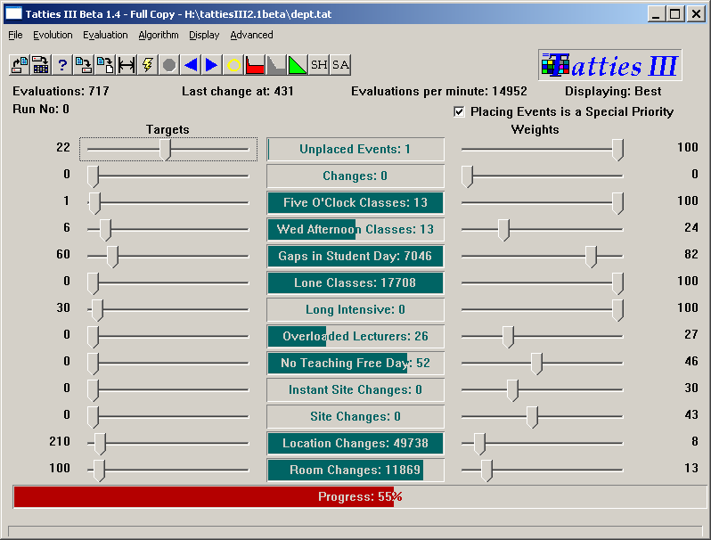

Slide 7
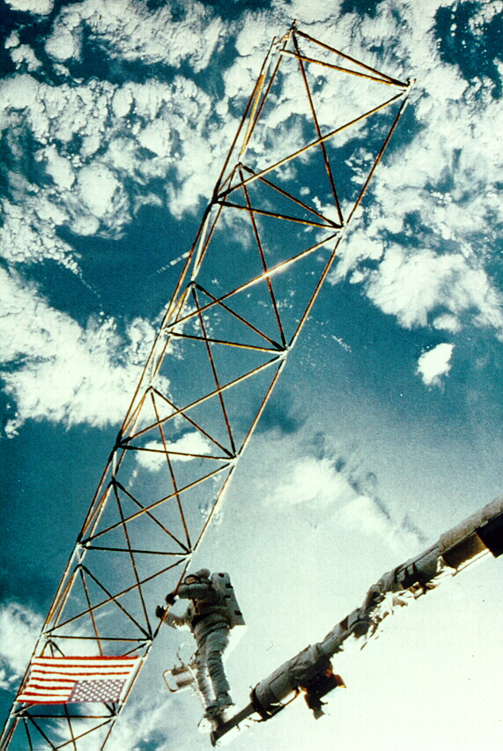
Optimisation example 2: satellite structure
Optimised satellite designs for NASA to maximize vibration isolation
Evolving: design structures
Fitness: vibration resistance
Evolutionary “creativity”

Slide 8
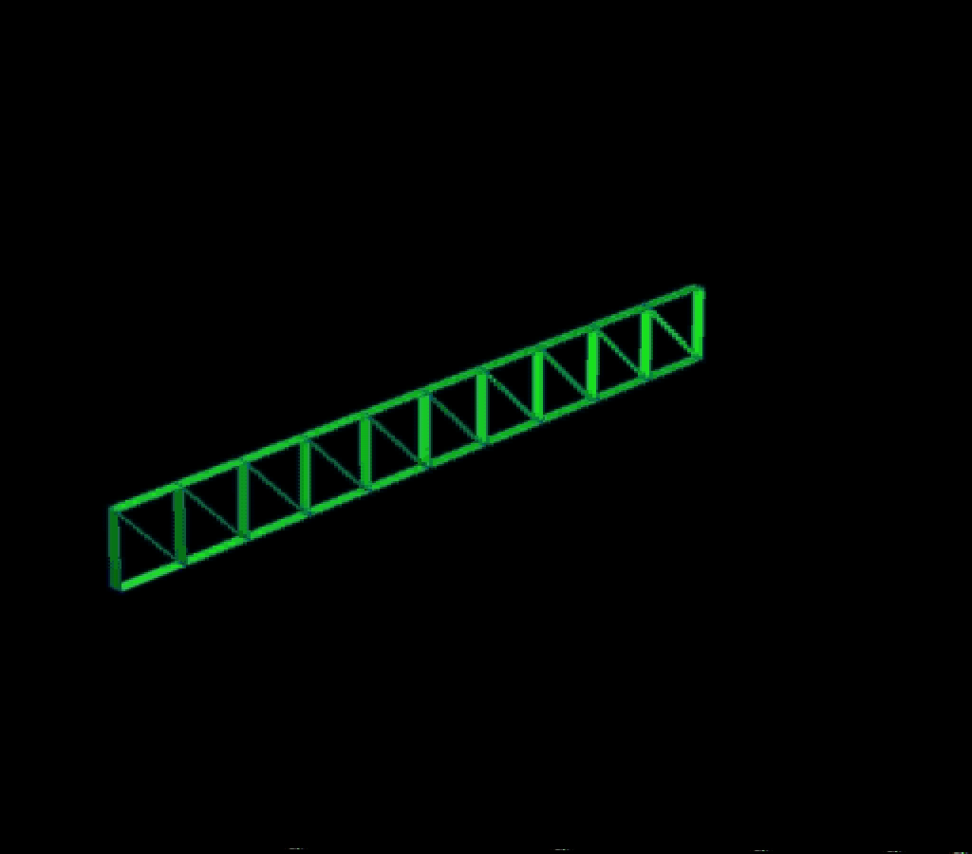

Slide 9
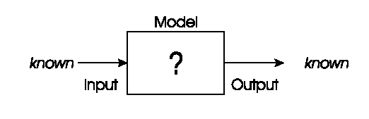
“Black box” model: Modelling
We have corresponding sets of inputs & outputs and seek model that delivers correct output for every known input
Note: modelling problems can be transformed into optimisation problems
Evolutionary machine learning
Predicting stock exchange
Voice control system for smart homes

Slide 10
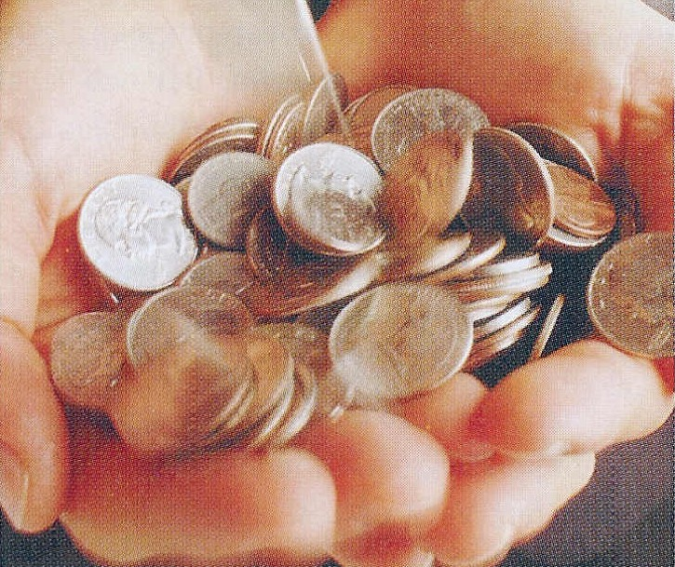
Modelling example: load applicant creditibility
British bank evolved creditability model to predict loan paying behavior of new applicants
Evolving: prediction models
Fitness: model accuracy on historical data

Slide 11
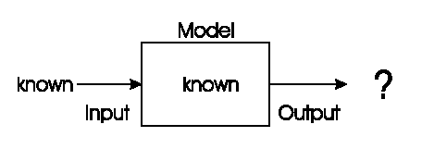
“Black box” model: Simulation
We have a given model and wish to know the outputs that arise under different input conditions
Often used to answer “what-if” questions in evolving dynamic environments
Weather forecast system
Impact analysis new tax systems
Evolutionary economics, Artificial Life

Slide 12

Simulation example: evolving artificial societies
Simulating trade, economic competition, etc. to calibrate models
Use models to optimise strategies and policies
Evolutionary economy
Survival of the fittest is universal (big/small fish)

Slide 13
Simulation example 2: biological interpretations
Incest prevention keeps evolution from rapid degeneration
(we knew this)
Multi-parent reproduction, makes evolution more efficient
(this does not exist on Earth in carbon)
2nd sample of Life
Picture censored

Slide 14
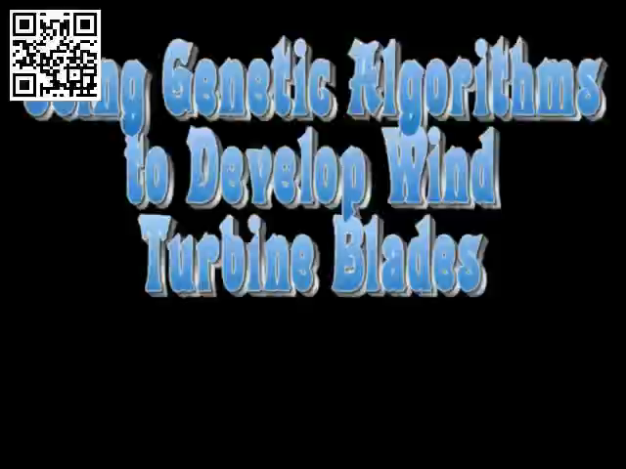
Example: evolving wind turbine blades
“That solution is really clever. That’s ingenious. And there was no designer to this blade, it just evolved.”
Wind turbine evolution (4’57”)

Slide 15
Search problems
Simulation is different from optimisation/modelling
Optimisation/modelling problems search through huge space of possibilities
Search space: collection of all objects of interest including the desired solution
Question: how large is the search space of different tours through n cities?

Slide 16
Problems vs. problem-solvers
Distinction between
search problems, which define search spaces, and
problem-solvers, which move through search spaces (to find a solution).

Slide 17
Optimisation vs. constraint satisfaction
Objective function: a way of assigning a value to a possible solution that reflects its quality on scale
Number of un-checked queens (maximize)
Length of a tour visiting given set of cities (minimize)
Constraint: binary evaluation telling whether a given requirement holds or not
Property of a chessboard configuration: are there queens that check each other? (we are good if “no”)
Property of a tour: is city X is visited after city Y? (we are good if “yes”)

Slide 18
Optimisation vs. constraint satisfaction
When combining the two:
Note: constraint problems can be transformed into optimisation problems – see exercise on next slide
 | Objective function
Constraints | Yes | No
Yes | Constrained Optimisation Problem | Constraint Satisfaction Problem
No | Free Optimisation Problem | No problem ☺

Slide 19
NP problems
So far: problem type depending on the problem only
Next: classification scheme by looking at properties of the problem solver
Benefit: we can define “problem difficulty”, by defining when a problem is hard to solve
cf. this stone is 100kg vs. this stone is heavy to lift

Slide 20
NP problems: Key notions
Problem size: number of problem variables (dimensionality) and number of different values for the problem variables
Running-time: number of operations the algorithm takes to terminate
Worst-case as a function of problem size
Polynomial (n²), super-polynomial (n^{O(log log n)}), exponential (2^{n})
Problem reduction: transforming current problem into another via mapping

Slide 21
NP problems: Class
The hardness / complexity of a problem can now be classified:
Class P: some algorithm can solve the problem in polynomial time (worst-case running-time for problem size n is less than F(n) for some polynomial formula F)
Class NP: problem can be solved and any solution can be verified within polynomial time by some algorithm Note: P is a subset of NP
Class NP-complete: problem belongs to class NP and any other problem in NP can be reduced to this problem by an algorithm running in polynomial time
Class NP-hard: problem is at least as hard as any other problem in NP-complete but solution cannot necessarily be verified within polynomial time

Slide 22
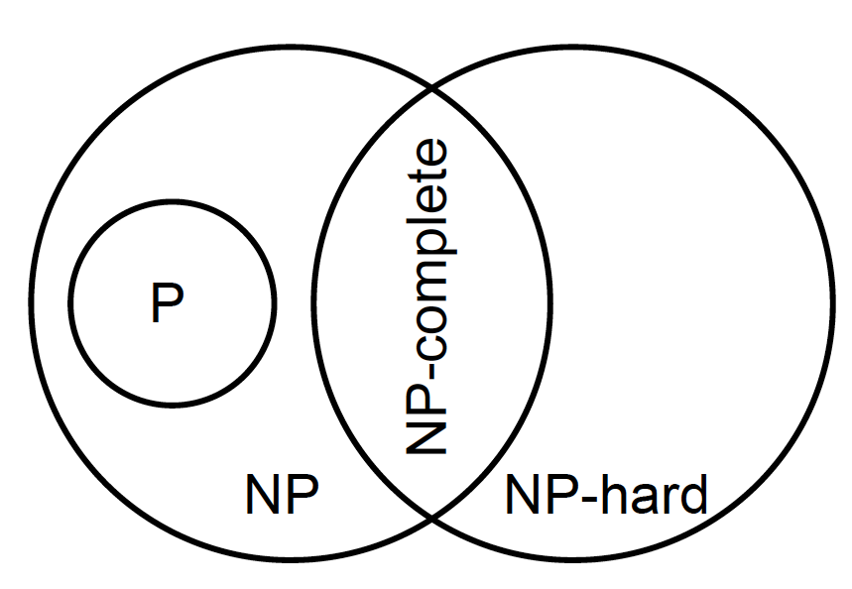
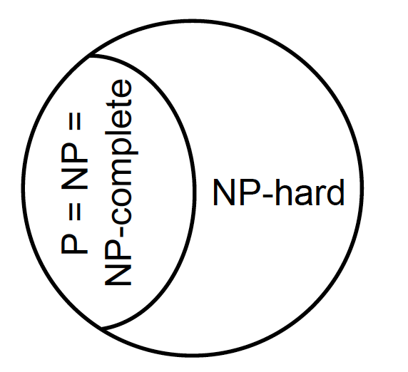
NP problems: Difference between classes
P is different from NP-hard
Not known whether P is different from NP
But if P = NP then P = NP = NP-complete
P ≠ NP P = NP
For now: use of approximation algorithms and metaheuristics

Slide 23
Important points
Optimization – modeling – simulation scheme (where is the “?” in the diagram)
FOP – COP – CSP scheme (2 x 2 matrix)
Problem hardness scheme (based on solver properties)
Other schemes exist, e.g., by the type of variables (continuous vs. discrete)

Slide 24
Q: WHAT TYPE IS THE WIND TURBINE EXAMPLE?

Slide 25
Question / exercise:
How can we formulate the 8-queens problem as a FOP/CSP/COP?
Approach:
Objective function(s)?
Constraint(s)?
Mix?

